Slide 1

Introduction to Organizational Change Management
Setting the Foundation for Change Practitioner Excellence
2026

Slide 2
Agenda
Instructor Introduction
Module Overview
What Is Organizational Change?
Change vs Transition
Why Change Initiatives Fail
Introduction to ACMP
Roles in Change Management
Key Terminology
Reflection Activity
Summary
Post‑Work
Pre‑Work for Module 2

Slide 3


Jo-Ann Balmer, MCMP
About Instructor
Director – Change Advisory Lead
Management Consulting
Background
Jo-Ann is an Organizational Change Management Director at RSM with over 25 years of experience in strategy, tactical turnaround methodologies and transformation across various industry verticals. Prior to RSM, Jo-Ann has over a decade in Operations, having managed organizations across three continents, that provides a vital operational perspective to modernization and digital transformation.
Jo-Ann is recognized for her global leadership in complex modernization and digital transformation projects, mergers and acquisitions and carve-outs, applying change management principles that positively affect adoption and productivity, while ultimately realizing gains in profit and efficiency to consistently exceed customer expectations.
Areas of Specialization
Organizational Change Management
Global Program, Project and Portfolio Management
Business Strategy and Alignment
Global Business Systems Implementations
Mergers and Acquisitions
Professional Credentials and Education
Master of Science – Business Administration – University of Ulster
Global Master Change Management Practitioner (ACMP);
ProSci Certified (ADKAR)
Other Certifications: Master Certified Business Coach (MCC) – International Coaching Federation
Industry Focus
Technology, Media and Entertainment (TMT)
Consumer Products (CP)
Financial Services
Health & Life Sciences
Manufacturing and Warehousing
Director
Change Advisory Leader
Phoenix, AZ
Jo-Ann.Balmer@rsmus.com
602.636.6149

Slide 4
Module Roadmap and where are We?
Module 1
Module 2
Module 3
Module 4
Module 5
Intro to OCM
Communications Plan
Communications Plan
Communications Plan
Communications Plan
Session 1
Session 1
Session 1
Session 1
Session 1
Foundations
Readiness
Stakeholder & Sponsor
What is Change Strategy
Comms Planning
Session 2
Session 2
Session 2
Session 2
Session 2
ACMP Standard
Change Impact
Engaging Stakeholders
Components of Strategy
Feedback Loops
Module 7
Resistance Management
Module 8
Measurement & Benefits
Module 9
Agile Change Management
Module 10
Capstone & Evaluation
Module 6
Training & Learning

Slide 5

Module Overview
This module builds the foundation for becoming an ACMP ‑ aligned Change Practitioner.
Understanding Organizational Change Management (OCM)
Introduction to ACMP Standard
Supporting Frameworks
Reflection Activity
Key Change Roles
Core Concepts of OCM
Why Change Initiatives Fail
Foundational Terminology

Slide 6
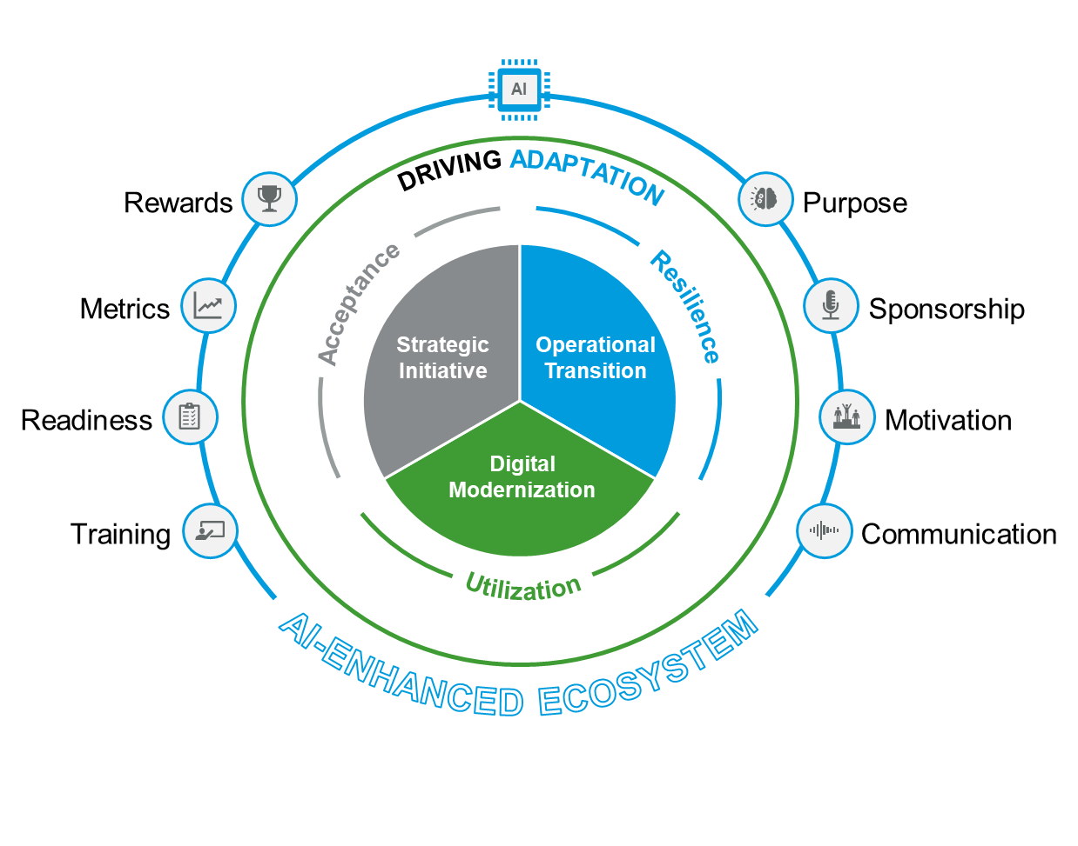
What Is Organizational Change Management?
“Empowering Change, Elevating Excellence”
Organizational change refers to shifts in strategy, structure, processes, people, culture, or technology.
Drivers include market dynamics, customer needs, digitization, regulation, and organizational growth.
Change impacts people first—emotions, identity, comfort, ways of working.
OCM – going beyond Communication & Training!

Slide 7
What Is OCM?
Why Organizations Invest in Change Management
Research consistently shows that projects with excellent change management are 6x more likely to meet objectives than those with poor or no OCM support (Prosci Benchmarking). Yet most transformation failures are not technical — they are people failures.
Three things OCM protects:
Speed of adoption — people reach proficiency faster when they're prepared, not surprised
Utilization — tools and processes only deliver ROI when people actually use them
Proficiency — adoption without competence is compliance without value
Our practitioners hold global and national change certifications:
Global ACMP
ProSci - ADKAR
Kotter's
McKinsey's
William Bridges
"The hardest part of any transformation isn't the technology. It's the people who have to live in it."

Slide 8
Change vs Transition
Change
Transition
Change is the external situation, event, or decision that is introduced to the organization.
It is tangible, visible, and often immediate.
Examples:
A new CRM system goes live replacing the old one.
The company restructures, merging two departments.
A process changes from manual approvals to automated workflow.
Transition is the internal, emotional, mental, and behavioral adjustment individuals must make to accept, adopt, and perform in the new reality.
It is intangible, personal, and takes time.
Examples:
An employee feels anxious about using the new CRM and worries they may not learn quickly enough.
Team members feel loss of identity when two departments are merged, and their old roles disappear.
Employees experience uncertainty or mistrust under a new leadership team until they see stability.

Slide 9
ACMP Process Groups
1
2
3
4
5
Evaluate Change Impact & Organizational Readiness
This phase begins early-often even before formal project kickoff. It overlaps heavily with Discovery and Initial Design stages.
Purpose: Understand impacts, readiness, risks, stakeholders, and capacity.
Formulate Change Management Strategy
Conducted during Discovery → Early Design.
Purpose: Define approach, guiding principles, sponsorship, resourcing, and engagement strategy.
Develop Change Management Plans
Created during Design → Build phases.
Purpose: Build communication, training, resistance, stakeholder, sustainment, and measurement plans.
Execute Change Management Plans
Runs throughout Build → Test → Deploy, often peaking near UAT, go‑live, and cutover.
Purpose: Deliver communications, training, engagement, coaching, feedback loops, and reinforcement activities.
Complete the Change Effort
Occurs post‑go‑live, through Stabilization → Adoption → Hypercare.
Purpose: Measure adoption, capture lessons learned, transition ownership to operations, reinforce behaviors.
Discover and Design Phase
Design
Build
Test
Deploy
Stabilize

Slide 10
OCM—Typical project lifecycle
Driving change with a strategic framework and global methodologies
Continue risk and resistance mitigation
Sustainability exercises
Feedback loops, lessons learned and recognition
Training and support
Success measure review against business outcomes
Finalize learning and development plan
Define the change
Value realization
Engage sponsors and stakeholders
Perform stakeholder analysis
Develop clear future state vision and success measures
Comprehensive communication plan
Define change impact and readiness strategy
Business process impact assessments
Go Live / Event

Slide 11
Roles in Change Management
1
2
3
4
5
Sponsor - Visible leader, decision maker
Provides direction, authority, and resources. Champions the change publicly and privately, removes barriers, and models desired behaviors. Success depends heavily on consistent sponsor engagement.
Change Practitioner - designs and executes OCM approach
Develops the strategy, assesses impacts and readiness, facilitates stakeholder alignment, builds plans, delivers communications/training, and monitors adoption. Serves as advisor to leaders throughout the project.
Managers - reinforce change with teams
Translate the change for their teams, address concerns, coach individuals, and reinforce new behaviors. They are the most influential group in driving day‑to‑day adoption.
Stakeholders - impacted groups
Experience changes in processes, tools, responsibilities, or culture. Their perceptions, readiness, and engagement directly influence adoption and project outcomes.
Change Agents - local influencers
Act as early adopters and on-the-ground champions. Provide feedback, socialize messages, help peers adapt, and surface risks or resistance early.

Slide 12
Introduction to ACMP
ACMP (Association of Change Management Professionals) is the global, nonprofit professional body dedicated to advancing the discipline and practice of change management. ACMP provides industry standards, professional certifications, global community engagement, and a shared language for practitioners worldwide.
What ACMP Does:
ACMP Certifications:
Defines global best practices through the ACMP Standard for Change Management, recognized worldwide for being vendor‑neutral and methodology‑neutral.
Builds a global community of change practitioners, leaders, and organizations committed to effective change delivery.
Provides professional development, webinars, conferences, and a large global network.
CCMP - Certified Change Management Professional
ACMP’s flagship credential validating deep knowledge of the ACMP Standard and real‑world change experience.
MCMP - Master Change Management Professional
MCMP is ACMP's highest-level global certification, recognizing mastery in leading complex, enterprise-wide transformations.
ACMP Website - https://www.acmpglobal.org/

Slide 13
Key Terminology
Key terms introduced in Module 1:
Adoption - Choosing to accept and demonstrate a new way of thinking or behaving. Adoption occurs when stakeholder behavior is consistent enough with the future-state behavior.
Benefit - The quantitative and qualitative, measurable and non-measurable outcomes resulting from a change.
Change - The transition from a current state to a future state
Change Impact - How people, process, technology, data, and the workplace are affected during the transition from the current state to the future state.
Change Management - The practice of applying a structured approach to the transition of an organization from a current state to a future state to achieve expected benefits.
Change Risk- An event or condition that, if it occurs, may have an effect on the change benefits.
Change Saturation - The condition in which the amount of change occurring in an organization is more than can be effectively handled by those affected by the change.
Competency - The organizational or individual collection of knowledge, skills, and abilities.
Engagement - Stakeholder involvement and influence in the change process.
Governance - The decision-making processes, applied by authorized individuals or teams, for approving/rejecting, monitoring, and adjusting activities of a change management plan.

Slide 14
Key Terminology
Key terms introduced in Module 1:
Outcome - A specific, measurable result or effect of an action or situation
Readiness - The preparedness of an organization or its parts to accept, effectively handle, and integrate impending change.
Resistance - A stakeholder's opposition to a change.
Sponsor - The individual or group in the organization that is accountable for the realization of the benefits of a change.
Stakeholder - An individual affected by a change.
Sustainability - The ability to maintain the future state.
Vision - The description of the future state.

Slide 15
Reflection Activity
Think of a significant change you experienced at work — a system rollout, a restructure, a new process, or a leadership change.
Answer these three questions (5 minutes individual, 5 minutes pairs):
What was the change?
Briefly describe the situation and what shifted.
2. How was it managed?
What did leadership do well — or not do — to bring people along?
3. What was missing?
Looking back through the lens of what you’ve learned today, what one OCM element (communication, sponsorship, readiness, sustainment) would have made the biggest difference?

Slide 16
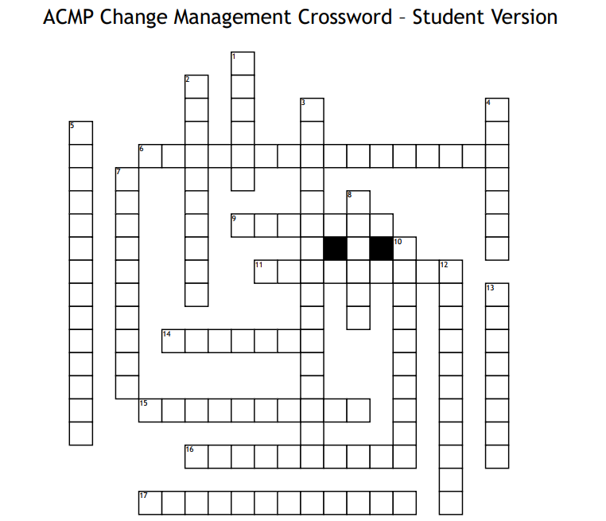
Exercise - Crossword
Across
6. Practice of applying a structured approach to organizational transition
9. Quantitative and qualitative outcomes resulting from a change
11. Preparedness to accept and integrate an impending change
14. Individual accountable for the realization of benefits
15. Event or condition that may affect change benefits
16. Decision-making processes for approving and adjusting change activities
17. How people, process, and technology are affected during change
Down
1. Transition from a current state to a future state
2. Stakeholder involvement and influence in the change process
3. An excessive amount of change occurring at one time
4. Specific, measurable result of an action or situation
5. Ability to maintain the future state
7. Collection of knowledge, skills, and abilities
8. Description of the future state
10. Stakeholder opposition to a change
12. Individual affected by a change
13. Choosing to accept and demonstrate a new way of thinking or behaving

Slide 17
Module Summary and suggested reading
What we Covered | Key Takeaway | ACMP Connection
What is OCM? | Change is external; transition is internal. Both require structured support. | Foundation
Why initiatives fail | Most failures are predictable — and preventable with early OCM investment. | Evaluate Readiness
ACMP Standard | Five process groups provide a methodology-neutral framework for any transformation. | All Domains
Roles in change | Sponsors authorize, practitioners design, managers reinforce, agents socialize. | Execute Plans
Key terminology | Shared language is the starting point for practitioner credibility. | Foundation

Slide 18
Post-Work — Module 1
Read
ACMP Standard for Change Management — Chapters 1–2 (Overview and Process Group 1)
William Bridges, Managing Transitions — Chapter 1: “It Isn’t the Changes That Do You In”
Observe
Look for one active change initiative in your organization (or a recent past one). Come to Module 2 prepared to answer:
Who is affected, and how?
How much advance notice did impacted groups receive?
What evidence of readiness planning (if any) can you identify?
Checklist
I can explain the difference between change and transition without notes
I can name and briefly describe all five ACMP Process Groups
I can articulate at least three reasons change initiatives fail
I have identified a real change initiative to use as my Module 2 case example

Slide 19
Pre-Work for Module 2
Coming Up: Change Impact Assessment & Organizational Readiness. Module 2 is where assessment work begins. To get the most from it:
Think ahead of time about your case initiative:
What groups of people are affected — and how deeply?
What behaviors, skills, or processes will need to change?
How change‑ready does the organization feel right now — on a scale of 1–10?
Preview question to bring to class:
If you had to guess today — what’s the single biggest readiness risk on your initiative?
There are no wrong answers. Module 2 will give you the framework to move from instinct to structured analysis.

Slide 20
Thank you
Notes:
Leader Instructional Notes
Ask if there are any questions.
Supplemental Information
Leader Preparation Notes
Participant Guide Content

Slide 21
Critical Success Factors during Digital Transformation
At RSM, we view challenges as opportunities. Outlined below, in no specific order, are potential challenges that may come up during the digital transformation and how we can collaboratively address them for a successful resolution.
Resistance to Change
Lack of Digital Skills
Data security and privacy
Implement comprehensive change management strategies including regular communication, training programs, and involving employees in the transformation process to gain buy-in.
Invest in continuous learning and development programs to address potential insufficient digital literacy by offering training sessions, workshops and certifications to build necessary skills.
Implement robust cybersecurity measures to decrease the risk of data breaches and non-compliance with regulations, conduct regular audits and training exercises.
Integration with Legacy systems
High costs and budget constraints
Maintaining Business Continuity
There can be difficulty integrating new technologies with existing legacy systems, develop a phased integration plan, leveraging APSs and middleware, consider modernizing legacy systems incrementally.
Digital transformation can be expensive and budget constraints limit progress. Prioritize initiatives based on ROI, seek executive sponsorship and explore cost-effective solutions.
Ensuring that operations are resilient enough to withstand the interruption and disruption during transition is pivotal to success, develop detailed transformation roadmap and milestones, conduct pilots and implement gradual change
Resource Capacity
Lack of project governance
Unrealistic project timeline
Identify potential conflicting initiatives and responsibilities up front. Communicate the level of involvement expected on the project as soon as it is understood and mitigate any potential resource constraints.
Establish clear roles, responsibilities, and communication channels for issue/risk resolution and decision making to keep the progress moving forward and to avoid any headwinds. Form the appropriate core team to make a final decision on the software once the selection evaluation is concluded to help drive the project forward. Governance is key to make any decisions when there are potential changes in scope.
Set realistic expectations on timing and milestones based on bandwidth and concurrent initiatives.
Potential challenge
Resolution / Critical success factors

